Slide 1

QF635: FUNDING RATE ARBITRAGE

Slide 2
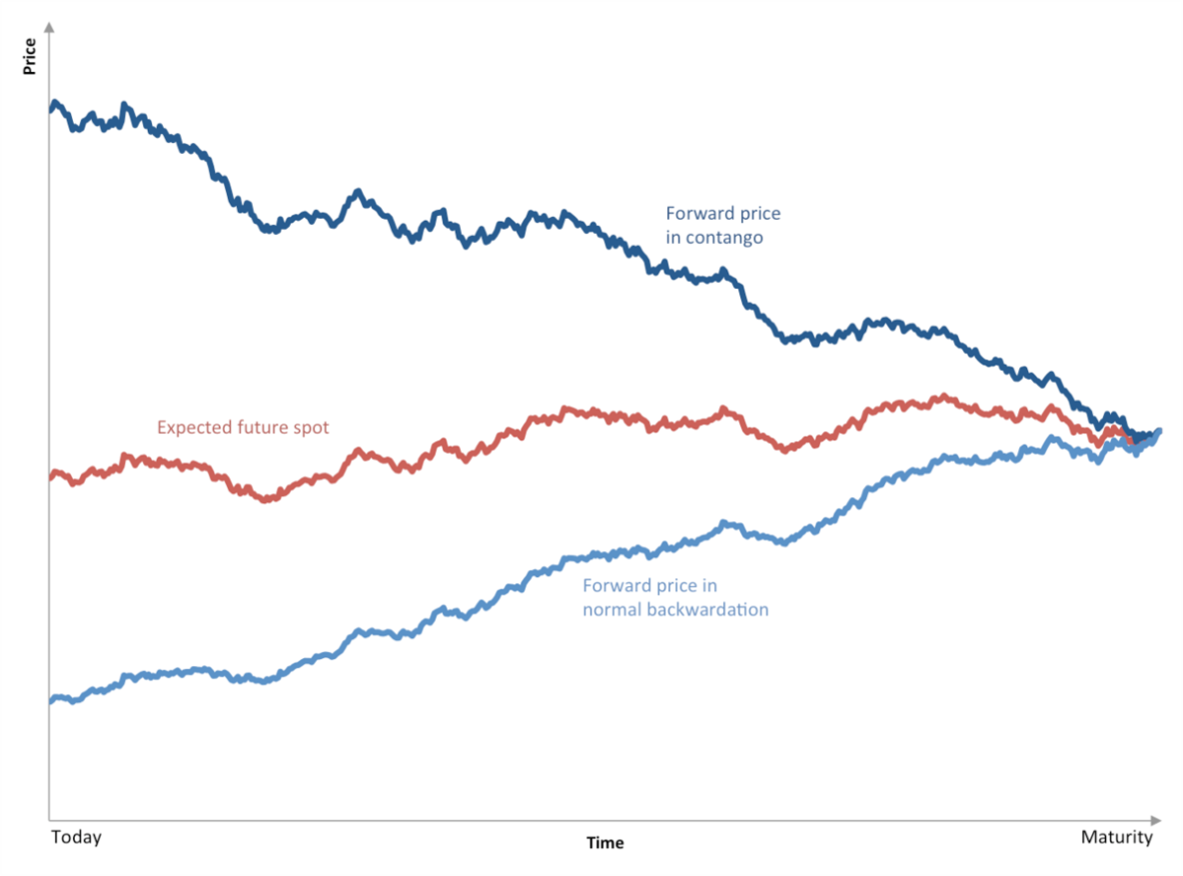
O V E R V I E W
Introduction
Funding Rate Arbitrage is common in cryptocurrency due to the presence of Perpetual Futures
Funding Rate Arbitrage
Mechanics
The simplest approach is to exploit the price discrepancy between Futures and Spot is to trade both of them together. Positive funding rate means longs pay shorts while negative funding rate means shorts pay longs.
Funding Rate
Premium Index
If the futures price is persistently higher than spot price, the funding rate will likely be positive.
Clamp (interest rate - premium index, 0.05%, -0.05%)
Fluctuates with magnitude of divergence, but capped between 0.05% and -0.05%
Price realignment. the expectation that the price will get back in line with the existence of the funding rate
|x-y|-E[spread to close our position]
Funding payments. the funding fees if we hold the position up to funding time
Expected to earn: Funding rate * x
Positive Arbitrage: When Futures are trading at a premium (Futures > Spot Price), and the funding rate is positive:
Sell Futures and buy Spot in 1:1 ratio (delta neutral)
Hold until the funding payment is collected or the spread compresses
Source:
Notes:
Negative Arbitrage: When Futures are trading at a discount (Futures < Spot Price), and the funding rate is negative:
Buy Futures and Sell Spot in 1:1 ratio
Collect funding payments and spread reversion.

Slide 3
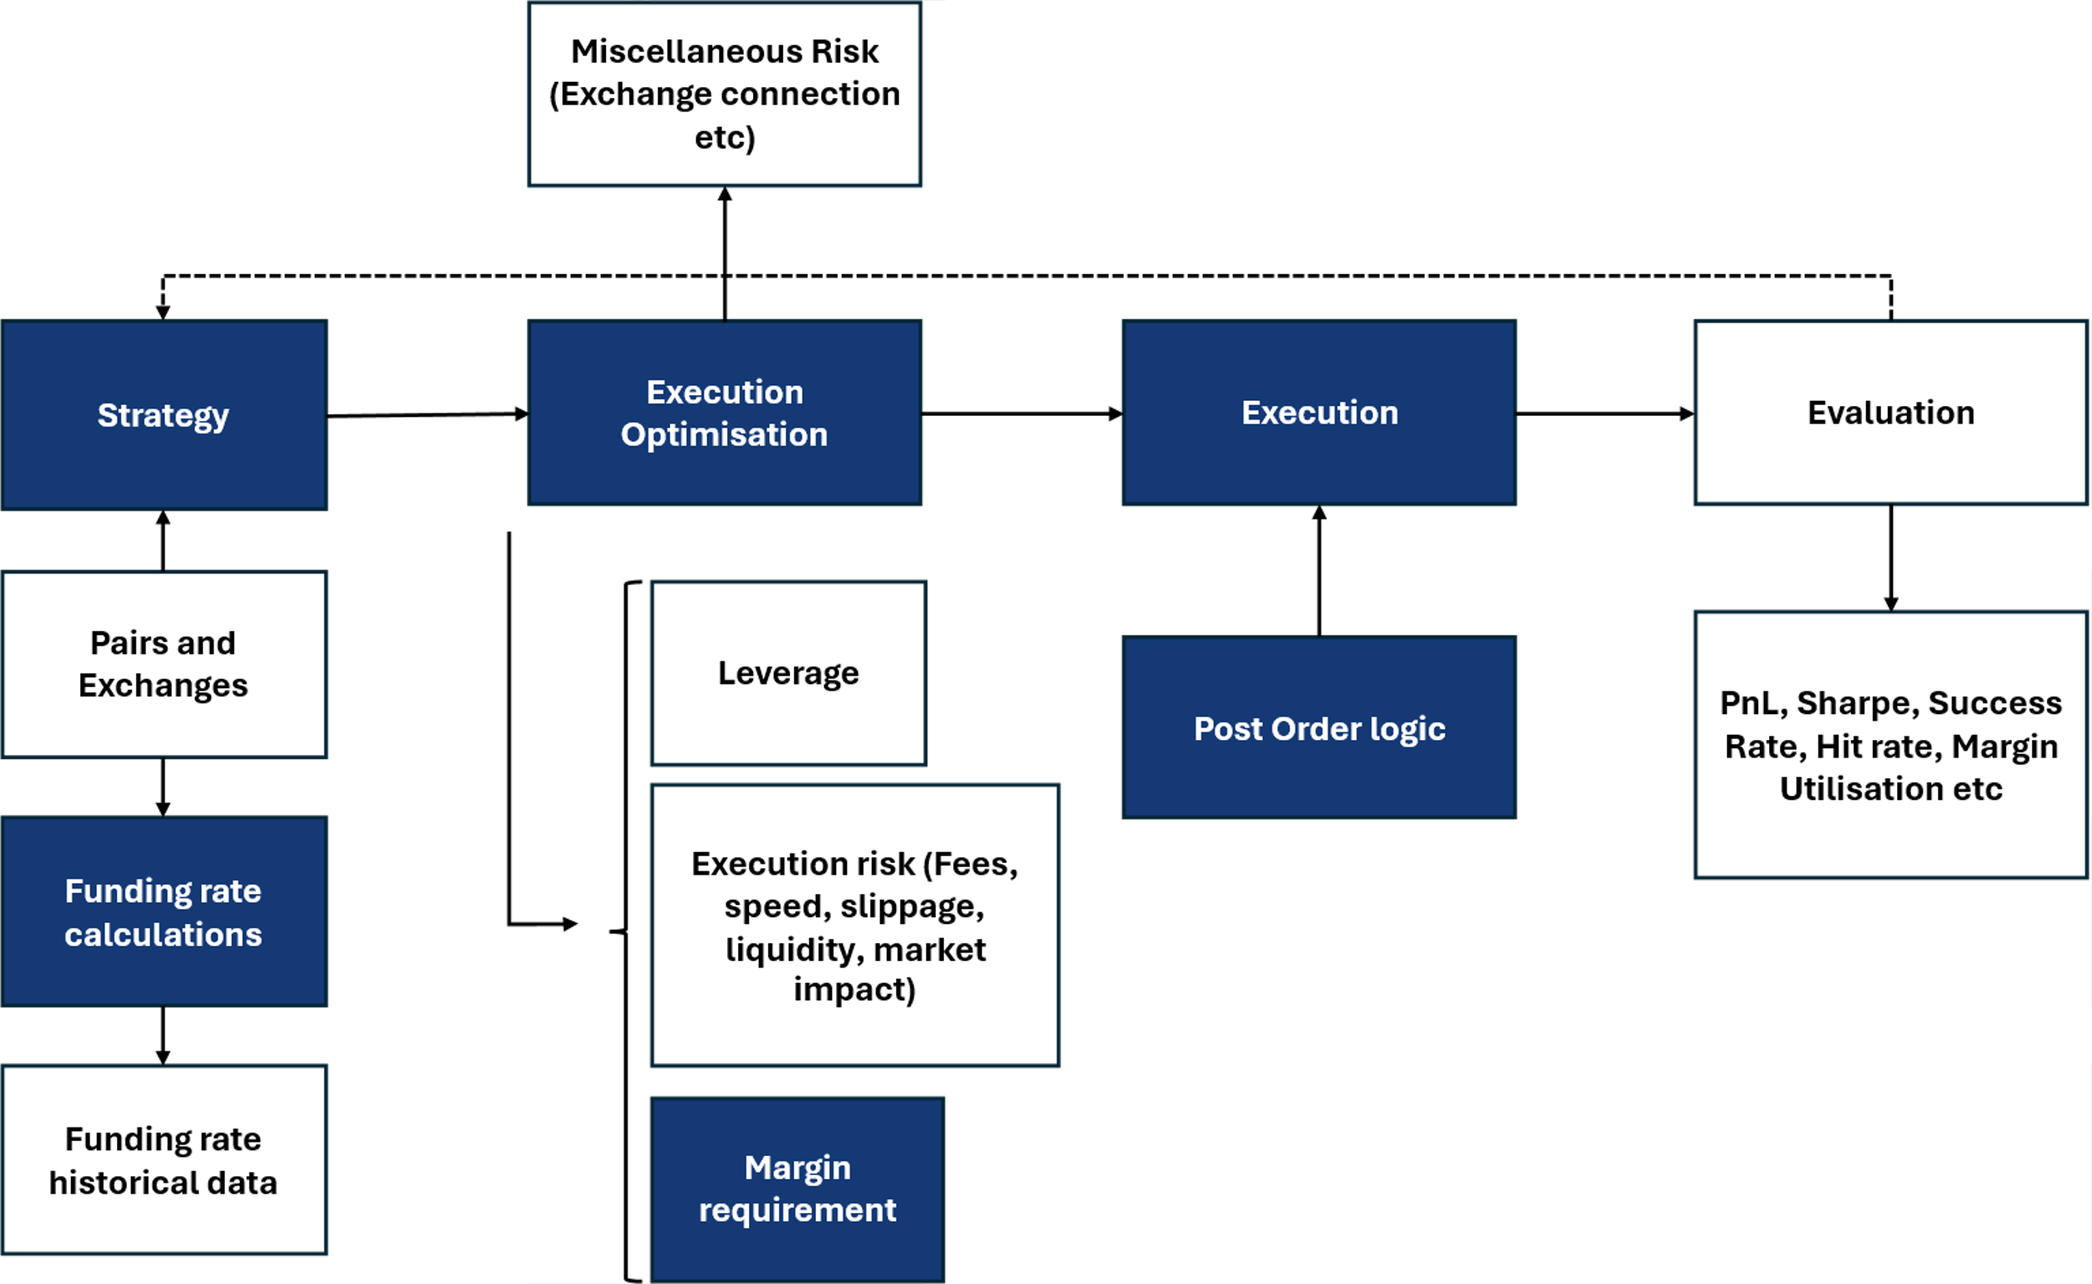
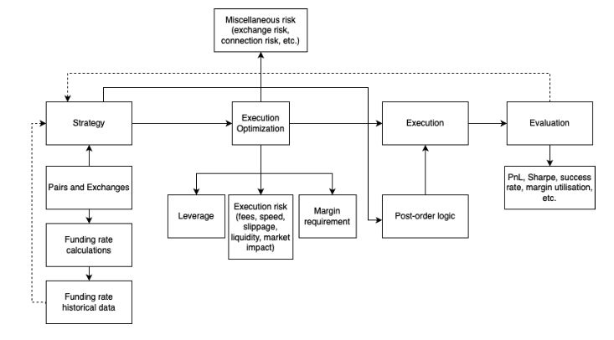
T R A D I N G S Y S T E M
Overview of Workflow
Have been implemented.
On a high level, we propose for a trading system with 5 main parts (focusing on first four)
Have not been implemented.
Model Architecture Considerations:
Pairs and Exchanges
Funding rate calculation
Execution
How to execute our orders? Limit Orders/ market orders
How much leverage do we use?
Portfolio Management
How many positions do we want in our portfolio
How do we square risk?
How to take profit and stop loss?
Efficiency in cost of capital? If we are losing on a position and there is another better opportunity, what do we do?
Post trades evaluation:
As we get more money, can we choose to enter more pairs?
Sharpe of our strategy?
Optimisation of liquidity
Source:

Slide 4
T R A D I N G S Y S T E M
Enhancement Of Strategy
Entry requirements can be quite strict initially, decreasing trade opportunities drastically
Entry Conditions: Is it Strictly Positive Rate?
Solution: Time to Funding Factor
1
Futures
>
Spot
1
Futures
>
Spot
2
Funding Rate
>
0
2
Funding Rate
>
0
3
Bid Ask
>
0.05%
3
Bid Ask
>
0.05%
4
Time to Funding
<
6 Hours to Next Funding
Condition for Positive Arbitrage
Alternate Scenario: Missed Entry Opportunities
1
Current Futures price
>
Spot
Condition for Positive Arbitrage
Additional Factor: If Futures Price > Spot price AND Funding Rate < 0:
Check time to next funding period.
If >6 hours to Funding, enter the arbitrage trade early, in anticipation that the funding rate will turn positive
As mentioned, since next funding rate is a function of the spread between Futures and Spot, this could be a good signal to enter the trade early.
2
Funding Rate
>
0
In this scenario, likely futures were trading below spot in the past 8 hours
However, if futures stay above spot until the next funding period, the funding rate will turn positive

Slide 5
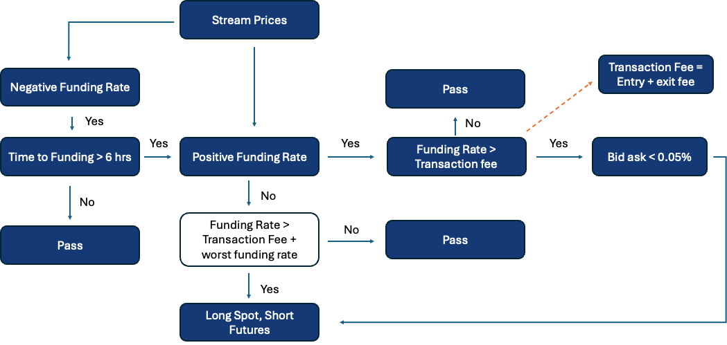
T R A D I N G S Y S T E M
Flow of Logic for Positive Arbitrage
Have been implemented.
Have not been implemented.
Entry conditions for positive arbitrage, defined as EDGE
Future bid – spot ask – entry fee of (future bid and spot ask) – exit fee of (futures bid and spot ask) – interest
Expectation: exit fee of (futures bid and spot ask) is uncertain, but should be in between the Futures and Spot normally
Note: Blue things are those included in model
If negative funding rate but >6hr, consider as positive

Slide 6
T R A D I N G S Y S T E M
Order Execution
Using Limit Orders have multiple benefits such as minimizing gap risk and cheaper rates
Order Combination | Pros | Cons
All Fill and Kill Limit Orders | Minimizes trading fees Able to get desired price No gap risk | High risk of partial fills, leaving unhedged exposure
All Market Orders | Guarantees full execution | High slippage risk, especially in volatile conditions
Hybrid: Limit Order + Market Order | Balance cost and execution certainty | Requires latency optimization, high risk of partial fills on the second leg
Immediate or Cancel IOC limit order:
Certainty of trade or cancel: to prevent our orders from staying on the order book. When there is a signal generated for execution of a trade position, it should be done immediately due to the relatively ‘high frequency’ that we are operating in. This ensures that we are getting into the position only when necessary, preventing erroneous trades.
Cheaper. We take the price maker fee since our orders add to the limit order book
Sources:

